Slide 1

Data Driven Education
Discussion Forum Subteam
Presentation 3 - 12/01/2021
Notes:
Pratik

Slide 2

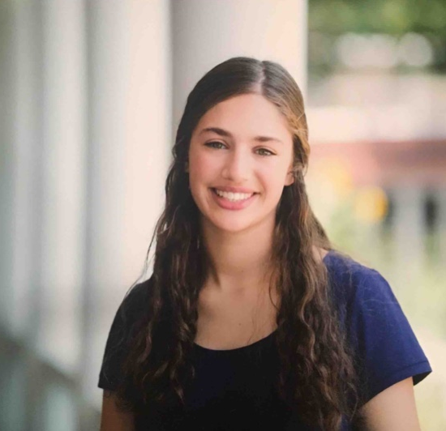



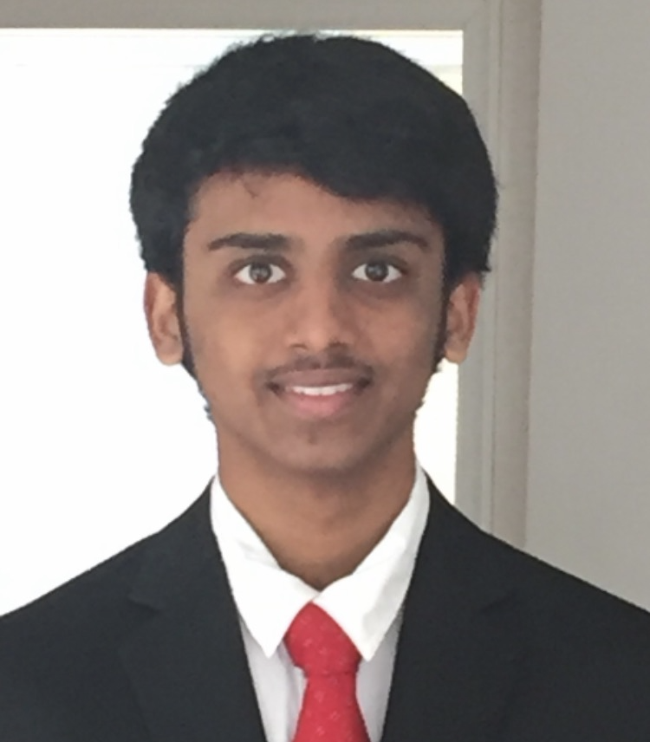

Team Members
Malav Patel
Data Scientist
Sarah Kaufman
Data Scientist
Nidhi Pai
Data Scientist
Pratik Agarwal
Project Manager
Aanya Khandelwal
Back-end
Developer
Gautam Sugasi
Back-end
Developer
Sambhav Jaideep
Front-end
Web Developer
Notes:
All

Slide 3


Introduction
Discussion forums
  Online formats - primary source of interaction
  CS 6601 - 155 threads, 1494 comments
Student interaction
  Cognitive presence
  Social presence
Activity on forums indicative of student engagement and interest
Goal: Creating a web application to be used by professors to make their courses more effective and engaging
Notes:
As a refresher, we’re working with Piazza Discussion forums data from Dr. Thad Starner’s CS 6601 course. Our goal is to create a web-app that can help reduce instructors’ workload, at the same time, allow them to track the engagement levels in their courses, and identify instances where their intervention is required. Examples include identifying posts that need their attention, get a representation of the class engagement both individually, and at a group level, as well as get alerts for peaking activity, usually expected around assignments or exams’ due dates.

Slide 4
Overall results and project goals for next semester
Category | Accomplished | Next Goals
Web Dev | Working dashboard on real data (sentiment) | Pilot testing with real users (instructors) Integration with Piazza/Ed
UX Research | Identified few key features of importance to instructors | Create relevant metrics from forums data Pilot study on a real course
Data Science | Sentiment scoring and cognitive presence model on Piazza+EdX Analysis of top contributors and correlation with grades | Use cognitive presence to inform metrics of relevance Identify highly connected and most contributing students
Learnings and Challenges as a Project Manager:
Important to coordinate the team as a whole, and scheduling of project tasks
Set expectations clearly at the start of semester for the team and each individual
Quicker iterations and faster feedback loops - focus on quick launch
Notes:
Talking of our results this semester, the web-dev team was able to integrate the web-app with the Data Science team’s sentiment analysis model getting the first version of our dashboard working on real Piazza data. Sambhav will be showing you a small demo. In terms of UX research, we were able to collect a few survey results and couple interviews with instructors to help prioritize metrics for the dashboard. More details to be shared by Gautam. The data science team was able to build 2 models, one for sentiment and the other for cognitive presence. On top of that, the team also analysed top contributors in the forums, and the influence of activity on student outcomes which will be elaborated by Malav, Nidhi, Sarah and Aanya. Our focus for the next sem will be on pilot testing the web-app, extracting the relevant metrics from forums data using our cognitive presence and sentiment models, and deepening our analysis on social presence. As a project manager, there are a few aspects I’d like to improve on based on reflections this semester. Mainly setting clear measurable goals at the start rather than in the middle, quicker feedback loops involving multiple interactions with target users, and better scheduling of tasks for each individual to minimize any bottlenecks in execution. Over to the Data Science team.

Slide 5
Data Science

Slide 6
Research Goal
Identify key factors influencing student engagement and performance in an asynchronous online classroom using the community of inquiry framework, and provide actionable insights to the instructors through the web app.
Notes:
Malav

Slide 7
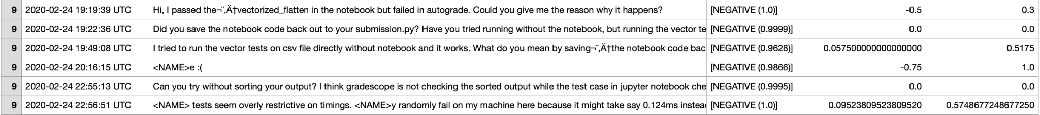
Sentiment Analysis and web-app integration
Flair: Generated a sentiment along with the confidence level.
Currently it took about 65-70 minutes for 1494 posts
Will be looking for processing comments in batches in future
Textblob: Generated a polarity score between -1 to 1
Observations: Polarity scores with the TextBlob model after an exam was seen to be slightly negative compared to other days.
Weaknesses:
- Both the pre-trained models were trained on IMDb movie data.
- Could not train the model ourselves due to lack of no. of posts
Notes:
Malav

Slide 8
Cognitive Presence (Garrison et al., 2001)
0: No Cognitive Presence
1: Triggering Event
2: Exploration
3: Integration
4: Resolution
Logistics
Socializing
“Thank you”
Unclear comments (code without comment)
Short questions
Technical clarification
“I am clueless”
“I think this is right/wrong”
Focus on the problem itself
Describing a problem
Giving suggestions
Partial understanding
Clarifications with detailed description or own assumptions
Proposing a solution
Giving their solution
Giving a textbook or other reference
Partial solutions
Confirmation of ideas
Elaboration on solution
Explain why/how solution works in detail
Definite comments
Comments from instructors
Direct answer
Notes:
Malav

Slide 9
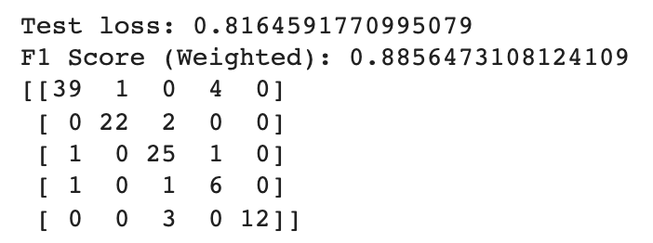




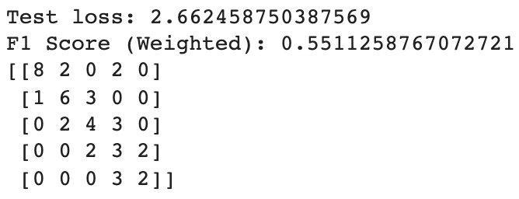


Cognitive Presence Modeling - Results and Analysis
Test and Trained on both Piazza and EdX data:
Test and Trained on EdX data:
Notes:
Malav

Slide 10
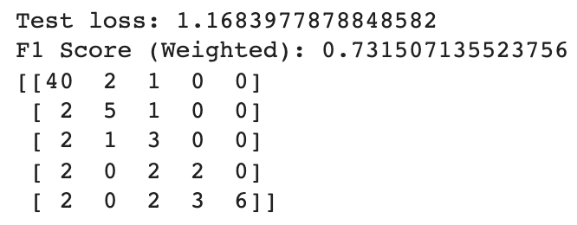




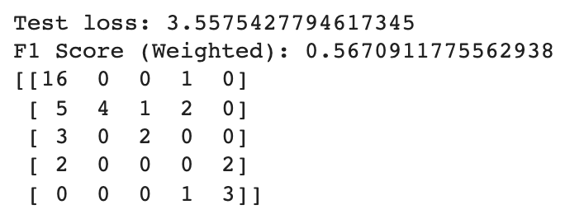


Cognitive Presence Modeling - Results and Analysis
3. Test and Trained on Piazza data:
4. Test and Trained on EdX data (train:test = 95:5)
Notes:
Malav

Slide 11
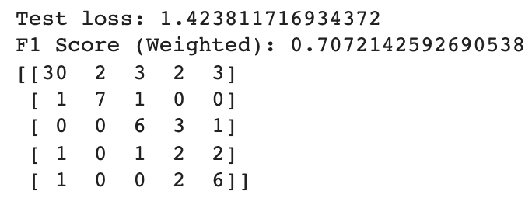


Cognitive Presence Modeling - Results and Analysis
5. Test and Trained on Piazza data (train:test = 95:5):
Notes:
Malav

Slide 12
Social Presence - Analysis of Top Contributors
Top five students with the most posts:
  tend to have very high grades ranging from 98% to 104% (due to extra credit)
  average sentiment is positive but close to neutral
  students with a large number of posts have a relatively low average cognitive presence
  these students would be good candidates to be future teaching assistants
Next steps:
  How does the number connections students have relate to other metrics?
  How do instructor contributions influence cognitive presence and sentiment of students?
  How do cognitive presence, social presence, and sentiment change over time within a course?

Slide 13
Student Outcomes Analysis
Examined cognitive presence, number of comments, length of posts, sentiment, timing, types of posts
Notes about data set
  Only have passing students (169 with grades)
  Mislabeled students and instructors
Findings
  Highest correlation with final grades: number of follow-ups (0.27)
  Followed by average CP (.13)
Number of answers
Cognitive presence
Final grades
Number of posts
Timing of posts
Notes:
Nidhi
organized in megathreads: the follow-ups are sometimes the answer, which makes categorizing by post type a little tricky

Slide 14
Metrics for Dashboard
Found metrics for dashboard based on Piazza data set
Top student answerers
  User 60 - 4 answers
  User 4 - 2 answers
Top student askers
  User 60 - 19 questions
  User 46 - 5 questions
Overall sentiment around an assignment/exam
  Highest sentiment: Assignment 4 Bonus Kaggle Competition (.57)
  Lowest sentiment: Assignment 4 - Part 1: Hand Tree & Performance Metrics (.06)
Notes:
answers: hard to tell what an answer is and what a question is

Slide 15
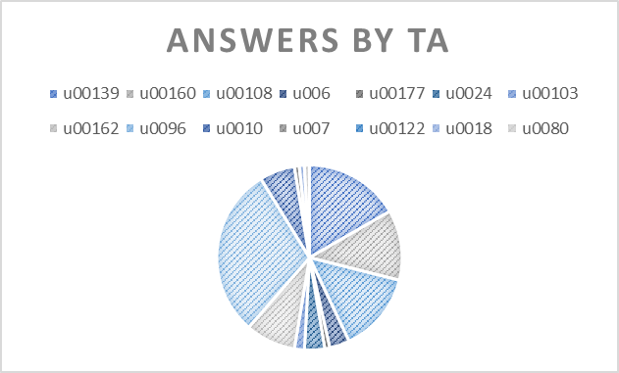
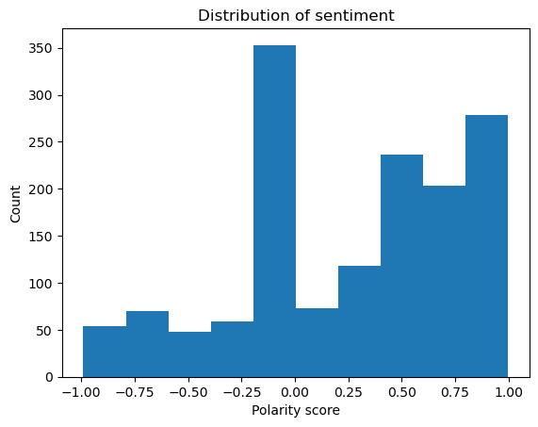
Metrics for Dashboard (cont)
Found metrics for dashboard based on Piazza data set
Distribution of instructor contributions
Distribution of sentiment by post
Notes:
answers: hard to tell what an answer is and what a question is

Slide 16
Data Science - Key Learnings and Goals for next sem
Learnings:
Sentiment Analysis: Although the pre-trained model was trained on movie data, it worked well to predict the sentiment of Piazza comments.
A bit inaccurate sentiment of a question unless some specific keywords are used.
Next Steps:
Complete the pipeline: comments -> polarity score and sentiment for real-time piazza data
Test this trained BERT model using LIME approach to identify impact of commonly used words on Piazza
Use the model to predict cognitive presence for real-time Piazza data and display it on dashboard

Slide 17
UX Research

Slide 18
User Surveys - Analysis
Metrics survey sent out to a few people initially to gather feedback
  Edited based off of feedback and resent to a broader group to get more responses
Three highest ranked metrics by average score:
  Most popular topic that is trending this certain week? For example, if a lot of students have questions on a particular topic.
  Overall sentiment around a given homework/exam? Sentiment of a post/thread is how positive or negative the tone of a given post is.
  Top students that answer the most questions?
Notes:
Gautam

Slide 19
User Surveys - Challenges & Next Goals
Some respondents also proposed their own metrics which they think would be useful to look at
  How often their questions are marked as 'good question' by TAs
  Category of post (course concepts vs logistics)
  Average time certain types of posts take to be resolved
With this, the metrics collection stage of the project is finished
  Can further interview certain TA’s and Professors if we need further input or assistance
  Next Steps:
    Work with the data science team to identify methods to extract the information from the data that is required for each metric
    Then, work with web development team to portray this information on the application
Notes:
Gautam

Slide 20
Interview
Interviewed James - TA for OMS Intro to Information Security
Use cases of Piazza metrics:
  Assessing TA performance and who’s contributing
Helpful metrics to include:
  Ranked urgency of posts
  Duplicate posts
Problem: Quality of questions can be low, show lack of research
Overall trends are more important than individual statistics
Look into:
  Sentiment over time
  How quickly a post blows up and how activity is sustained

Slide 21
Web Development

Slide 22




Web-App Progress
SQLite3 database of student discussion posts, as well as the sentiment, polarity, subjectivity of the posts
Fetching and processing data from database (forum_database.py)
Creating graphs using matplotlib and saving them as images
Serving images and other webpage elements on web-app using Flask

Slide 23
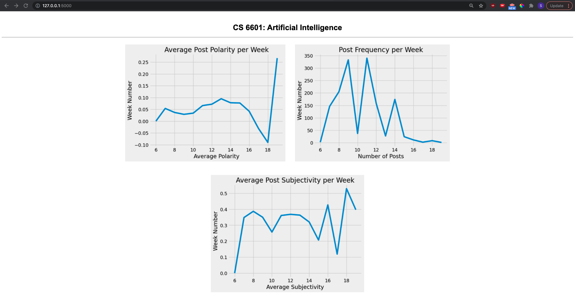

Slide 24
Back-End Web Development
For this iteration we chose to start with sentiment analysis using flair model to build the backend
Employed Python and SQLite3 to build a relational database table
  Extracted data from .csv format and converted the same to a .db file
  Data can be accessed through code in Python or through DB Browser for SQLite
Working through connecting front-end with database environment using Flask

Slide 25

Looking Back on the Semester
So, how did we do on the goals we set in August?
Web-App
create pipeline from database to front-end
prioritize basic, simple design/features
basic data visualizations
Logistical/Research
documentation!
professor insights on UI/UX
cohesiveness and communication between subteams

Slide 26

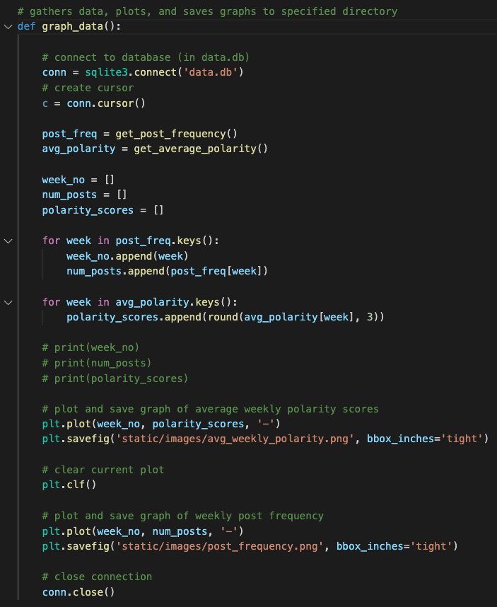
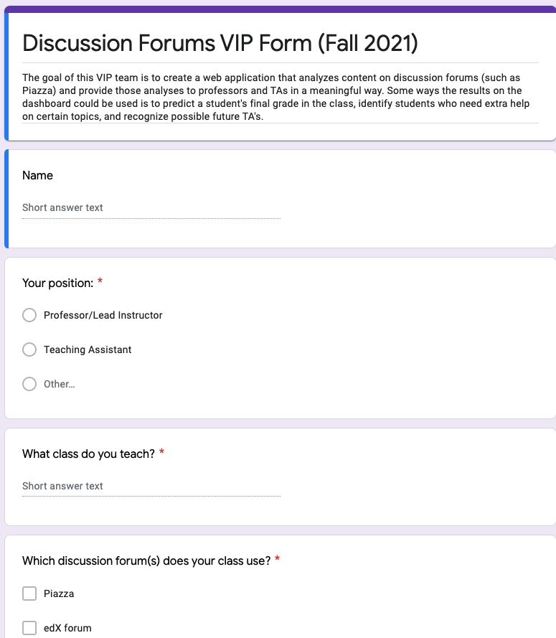
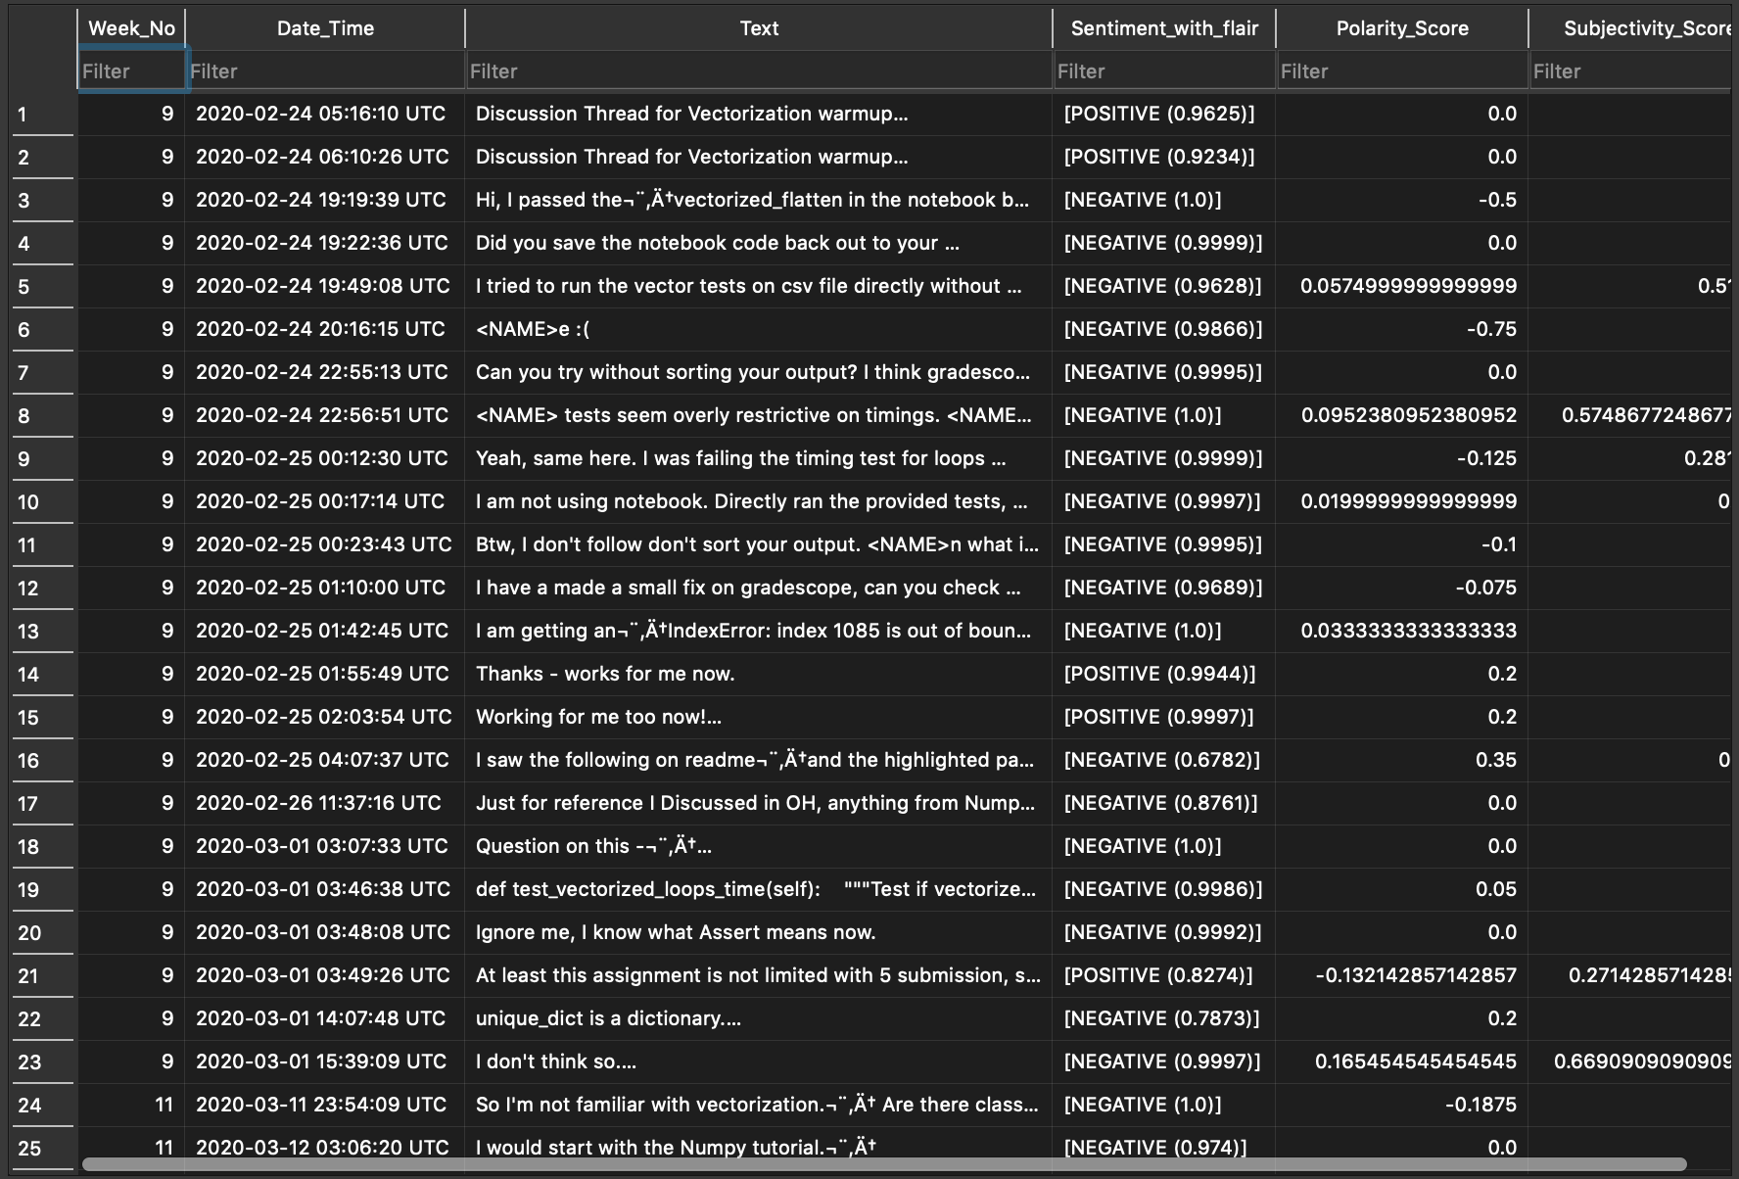
Deliverables
Created solid design plans using Figma prototyping
Second semester of sending out surveys to professors and TAs
Script to process and visualize data
Implemented a functioning database

Slide 27

Web-Dev Goals for Next Semester
Web-App
fetch Piazza discussion forum data → database
graphs as images (hosting?) or through libraries (Chart.js for React?)
spend some time on design to get closer to design goals
rethink our development stack (only Flask?)
Logistical
more cohesive web-dev team
incremental progress
narrow our focus

Slide 28
Conclusion
Our progress this semester, and direction for next semester:
Overall Project Outcomes (Web-app)
  Working dashboard showing metrics calculated using models created by DS team
  Proposal for pilot testing the app on a real course - Need to connect with instructors
Data science
  Cognitive presence classification model using BERT, and a sentiment analysis model
  Analysis of top contributors, periods of peak activity in course and sentiment around that
UX research
  Need to conduct a few more interviews with instructors and the PARQR team
  Construct metrics based on discussion forum data to represent info that instructors want
Notes:
To conclude, this sem we were able to get a working dashboard showing results from real course data extracted from Piazza. In terms of next steps, we’ll need to conduct a few more interviews to get deeper insights into the metrics to track. We also think it’d be helpful to talk to the PARQR team since they’ve been working with similar data. Our focus next semester will be (if possible) to pilot test our web-app with a few instructors in near real-time and using our trained cognitive presence and sentiment analysis models to inform the metrics that’d be the most valuable for our target users, the instructors. And that’s all for today. Thank you for your time.

Slide 29
Citations
Garrison, D. R., Anderson, T., & Archer, W. (1999). Critical Inquiry in a Text-Based Environment: Computer Conferencing in Higher Education. The Internet and Higher Education, 2(2–3), 87–105. https://doi.org/10.1016/S1096-7516(00)00016-6
Garrison, D. R., Anderson, T., & Archer, W. (2001). Critical thinking, cognitive presence, and computer conferencing in distance education. American Journal of Distance Education, 15(1), 7–23. https://doi.org/10.1080/08923640109527071
Devlin, J., Chang, M. W., Lee, K., & Toutanova, K. (2018). Bert: Pre-training of deep bidirectional transformers for language understanding. arXiv preprint arXiv:1810.04805.
Medhat, Walaa, Hassan, Ahmed, Hoda, Korashy (2014). Sentiment analysis algorithms and applications: A survey. Ain Sham Engineering Journals. https://doi.org/10.1016/j.asej.2014.04.011

Slide 30
Questions?

